Slide 1
Text images enhancement and OCR Text extraction presented to: prof. Waleed Al-Atbany

Slide 2
Project analysis slide 2
Outline
1
2
Introduction
2. Read Image and test OCR
PROJECT
3
4
Processing the Image
View results

Slide 3

introduction

Slide 4
Project analysis slide 4
Introduction
Our project aims to enhance text images before extracting the text using OCR
We used python in our processing
We used OpenCV (CV2) library mainly in our processing
We used other libraries like: (numby, matplotlib, pytesseract, PIL)
This project helped us in:
apply the course content
know OpenCV library
Help us In our graduation project

Slide 5
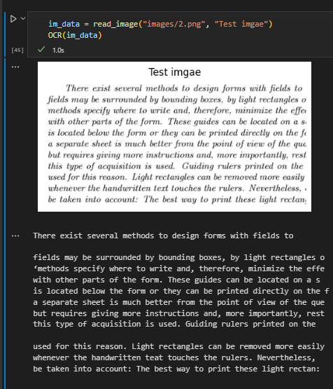
Project analysis slide 5
Image Preprocessing
Useful Functions Predefinition and Test OCR
Read and display image
Display functions
Use OCR function

Slide 6

Image processing
Gray-scale conversion
Inverse image
Thresholding
Morphological operations
Noise Removal
Gaussian noise removal
Salt and paper noise removal
Remove noise Using contours
Rotation / Deskewing

Slide 7
Thank You let’s go to the notebook

